Slide 1
Introduction to Rigor, Transparency and Reproducibility in Research
Andrew Wilson, Phd, Mstat
FORMER: Director of Applied statistics & Assistant Professor, Emma Eccles Jones Nursing Research Center, College of Nursing
And thanks to: Hollie Fuhrmann, MA
Research Associate, Emma Eccles Jones Nursing Research Center, College of Nursing

Slide 2
Introduction to Rigor, Transparency and Reproducibility in Research

Slide 3
Agenda
We will first provide an introduction to the problem of irreproducibility (defining key terms and concepts).
We will follow with an overview of the cultural shift and introduce emerging tools and tactics for supporting and encouraging rigor and reproducibility in research.
Introduction of the Open Access movement.
Finally, we will review the latest guidelines and policies from the National Institutes of Health regarding rigor and transparency, including new review criteria for grant proposals.

Slide 4
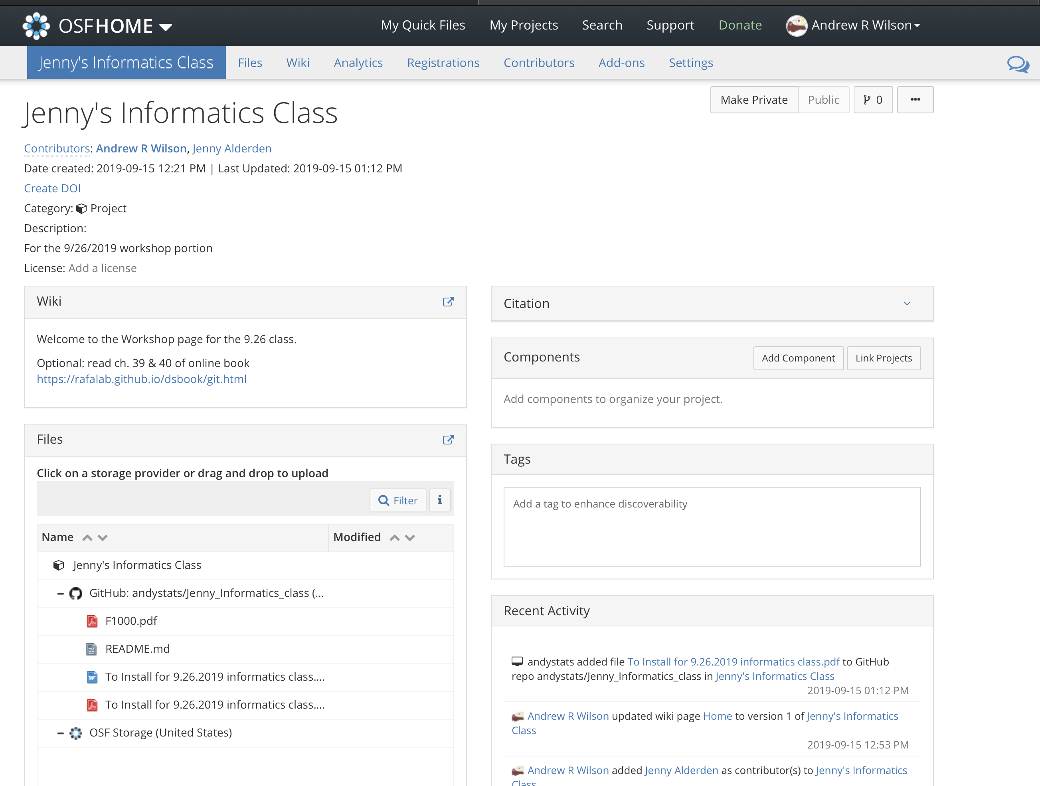
Then HANDS-ON Collaborative example!

Slide 5
What is Reproducibility?

Slide 6
What is reproducibility?
Computation Reproducibility:
If we took your data and code/analysis scripts and reran it, we can reproduce the numbers/graphs in the original paper
Empirical Reproducibility:
We have enough information to rerun the experiment or survey the way it was originally conducted
Replicability:
We use your exact methods and analyses, but collect new data, and we get the same statistical results

Slide 7
Other terms:
“A NEW LEXICON FOR RESEARCH REPRODUCIBILITY”
Methods reproducibility - the provision of enough detail about study procedures and data so the same procedures could, in theory or in actuality, be exactly repeated.
Results reproducibility - (previously described as replicability) refers to obtaining the same results from the conduct of an independent study whose procedures are as closely matched to the original experiment as possible.
Inferential reproducibility – Drawing qualitatively similar conclusions or claims of similar strength from either an independent study [or a reanalysis of the original study].
S Goodman, D Fanelli, J Ioannidis – SCIENCE Translational Medicine (2016)

Slide 8

The Problem

Slide 9

”Early signs”
Almost all biomedical studies currently are “statistically significant”
In a survey of 389 epidemiological studies published in 2004-2005 in major general and specialty medical journals, 89% highlighted some statistically significant relative risk
Kavvoura et al. PLoS Medicine (March 2007)

Slide 10
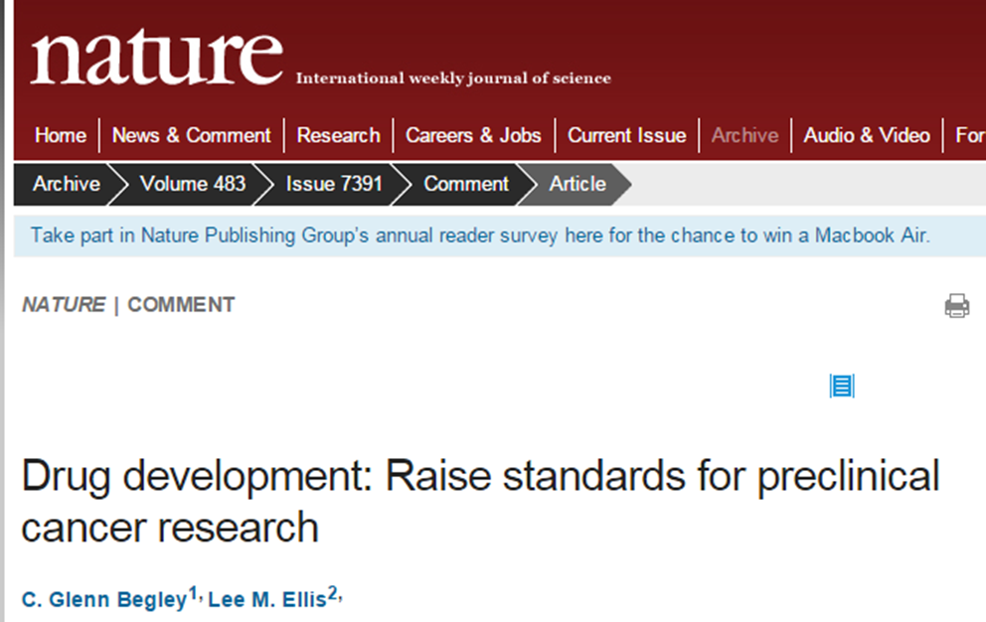
Scientists at Amgen tried to replicate 53 studies that they considered landmarks in the basic science of cancer, often co-operating closely with the original researchers to ensure that their experimental technique matched the one used first time round.
They were able to reproduce the original results in just 6 of the 53 (11%).

Slide 11
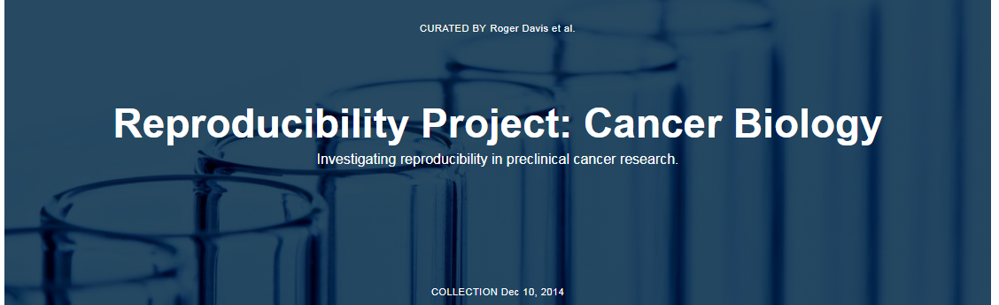
The Reproducibility Project: Cancer Biology is an initiative to independently replicate selected results from a number of high-profile papers in the field of cancer biology.
The collaborators identified 50 high-impact preclinical cancer papers published from 2010 to 2012, began writing protocols to replicate key experiments, and published the plans in eLife.
First batch of results: Rigorous replication effort succeeds for just two of five cancer papers
https://www.nature.com/news/cancer-reproducibility-project-releases-first-results-1.21304

Slide 12
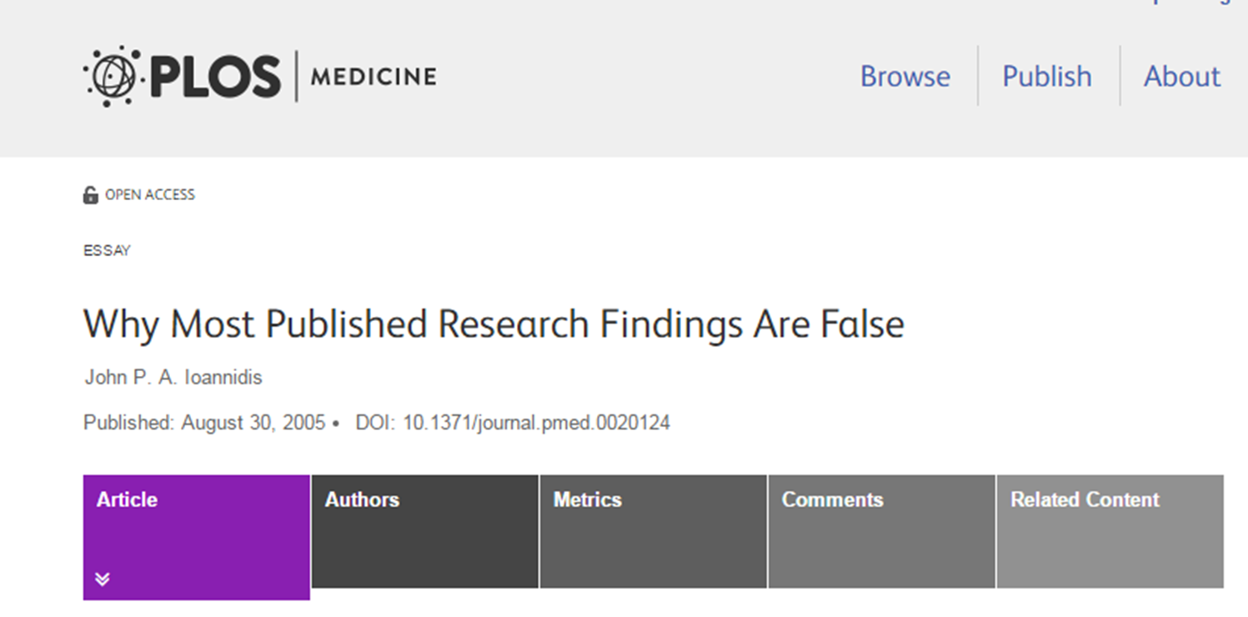
“It can be proven that most claimed research findings are false”

Slide 13
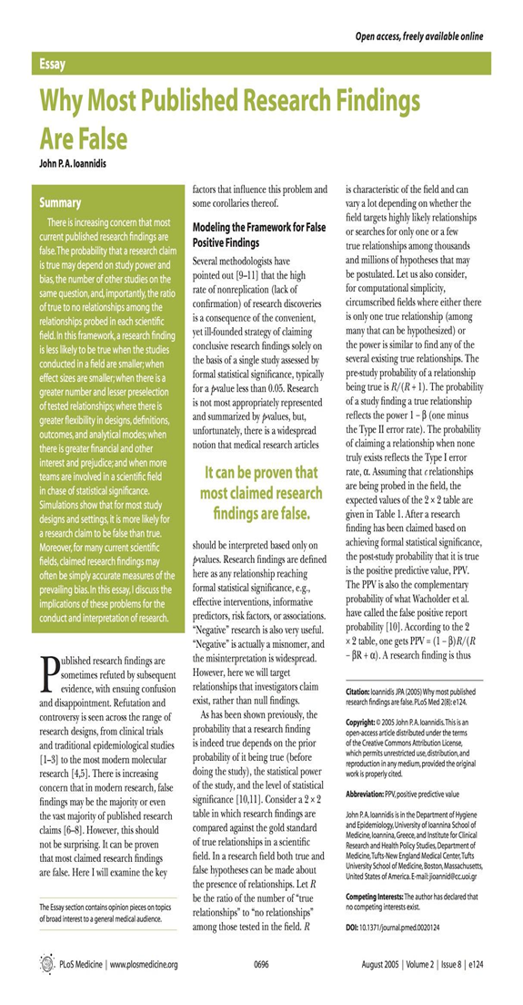
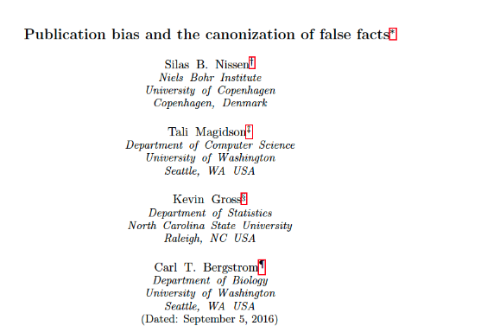
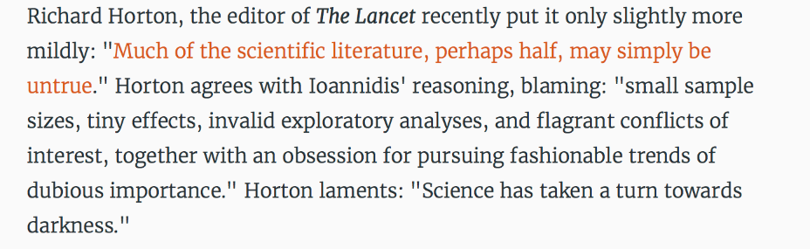
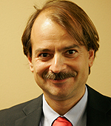

Slide 14
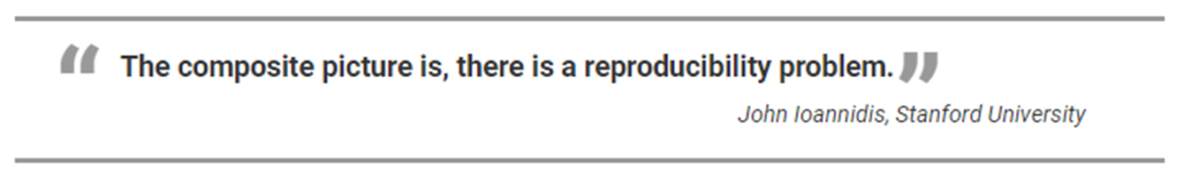
“I don’t share your optimism”
-Andy’s stats mentor, 2021

Slide 15
Potential sources of problem
Combination of factors:
Psychological
Incentives
Technical
The main problem isn’t fraud, but that many scientific findings in a wide variety of fields don’t replicate, and that the published literature has a very high rate of false-positives.

Slide 16
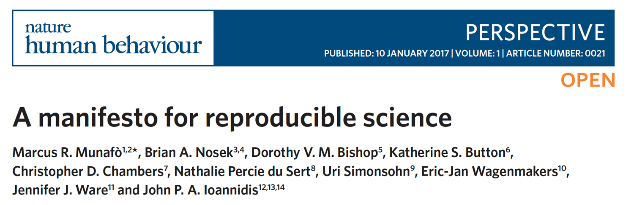
Psychological

Slide 17

Psychological
A hallmark of scientific creativity is the ability to see novel and unexpected patterns in data.
However, a major challenge for scientists is to be open to new and important insights while simultaneously avoiding being misled by our tendency to see structure in randomness.
The combination of apophenia (the tendency to see patterns in random data), confirmation bias (the tendency to focus on evidence that is in line with our expectations or favored explanation) and hindsight bias (the tendency to see an event as having been predictable only after it has occurred) can easily lead us to false conclusions.

Slide 18
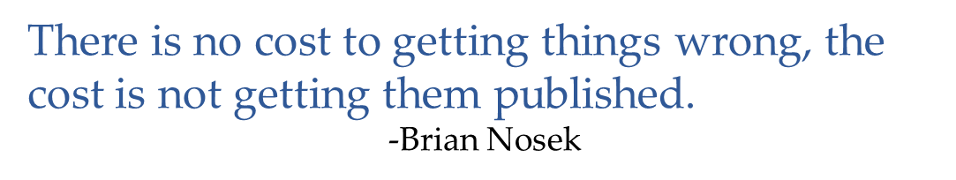
Incentives/Cultural
No interest in replication “why come in second” ?
Fascinating findings over meticulous methods.
Scientists have huge incentives to publish papers & journals are more likely to publish results that reach statistical significance.

Slide 19
Technical
HARK’ing (Hypothesizing After Results Known)
No (pre-registered) research plan
No shared/structured workspace or material archive
Low power/sample size
No documentation and lack of transparency
Data analysis can be rapid, flexible and automated.
In a high-dimensional dataset, there may be hundreds or thousands of reasonable alternative approaches to analyzing the same data. (R.D.F.)
Notes:
RDF: Researcher degrees of freedom

Slide 20
Researcher Degrees of Freedom
All data processing and analytical choices made after seeing and
interacting with your data
Should I collect more data?
Which observations should I exclude?
Which conditions should I compare?
What should be my main DV?
Should I look for an interaction effect?
Akin to HARK’ing

Slide 21
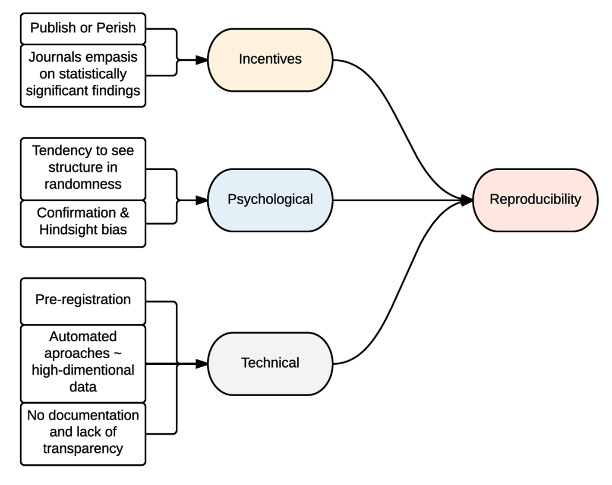

Slide 22
Potential Solutions

Slide 23



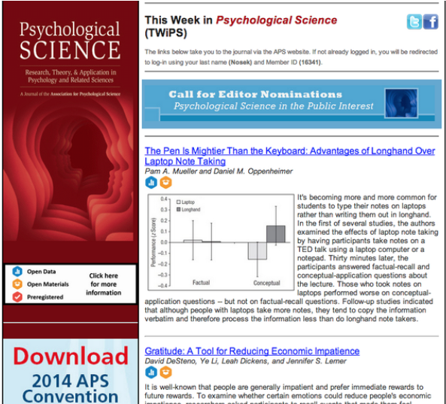
Potential solutions
New incentives, e.g., badges

Slide 24


https://cos.io/prereg/

Slide 25
Potential solutions
New culture
Embrace Reproducible Research
Care about replicating “on both sides”

Slide 26
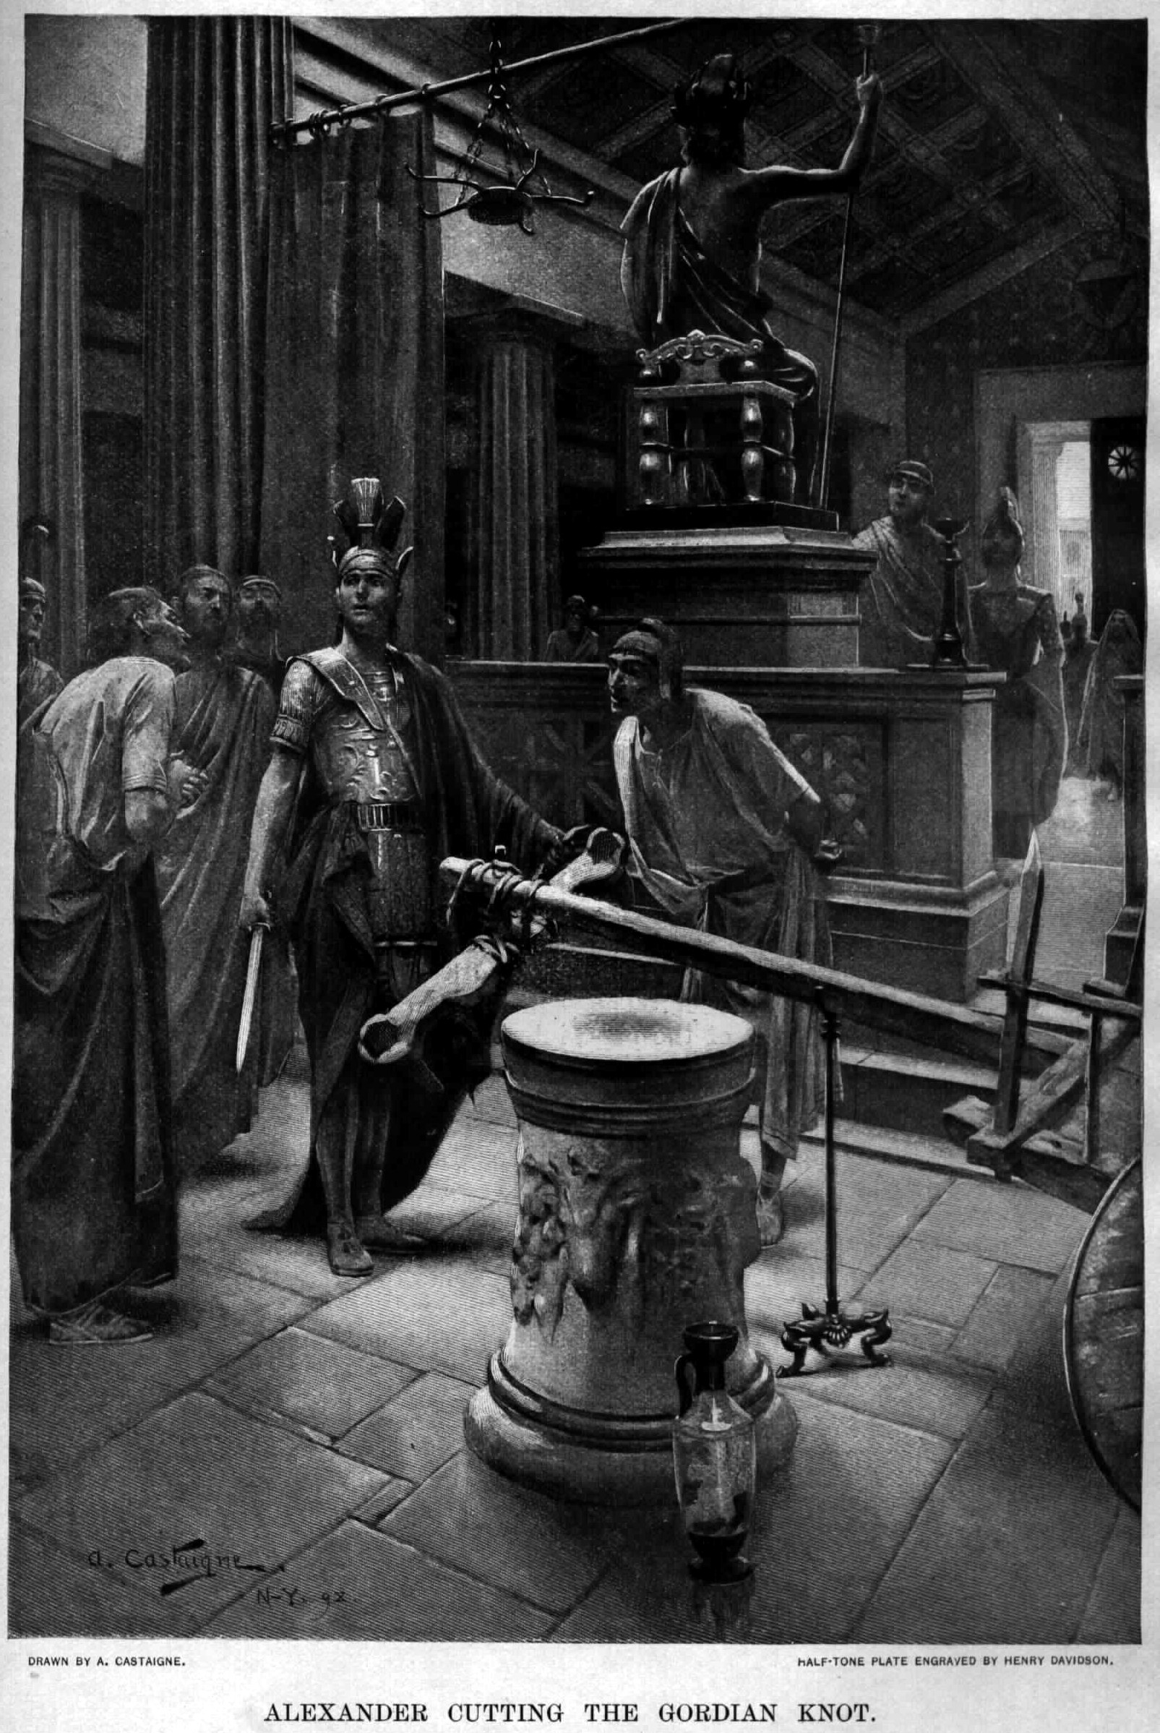
Potential solutions
New culture
Cutting the Gordian knot
Intractable problem solved easily by finding a loophole or thinking creatively.

Slide 27
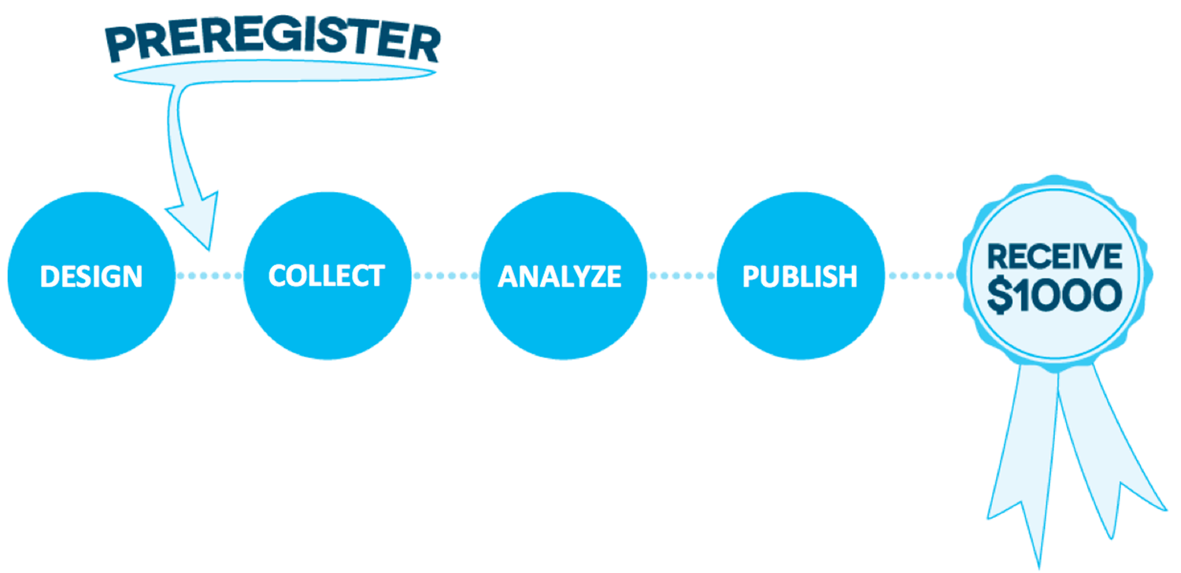
The $1,000 Preregistration challenge
ended on December 31, 2018

Slide 28
Is anyone pre-registration curious?
That’s a start!

Slide 29
Potential solutions
New tools

Slide 30
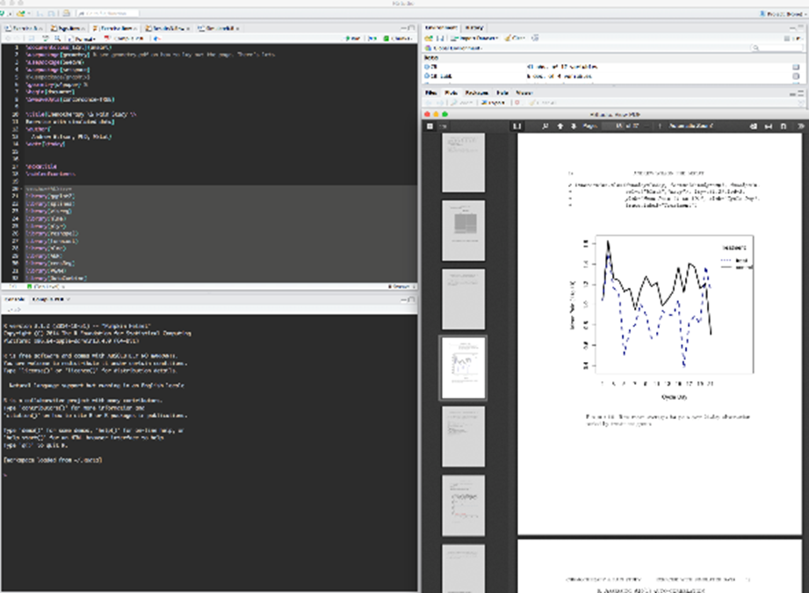


Tools for Reproducible Research
Literate programming, e.g., Sweave, RMarkdown:
create dynamic reports, which can be updated automatically if data or analysis change
Collaborative platforms, preferably with version control, e.g., GitHub
bookdown, blogdown…

Slide 31

https://osf.io
sensitive confidential data
-not yet

Slide 32
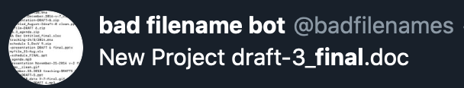
Tips from kbroman.org/steps2rr/
“Perhaps the most important step to take towards ease of reproducibility is to be organized.”
Encapsulate everything within one directory.
Separate raw data from derived data and other data summaries.
Separate the data from the code.
Use relative paths (never absolute paths).
Choose file names carefully.
Avoid using “final” in a file name.
Write ReadMe files.

Slide 33
Tools are important, but more important is the motivation to make study reproducible, i.e., more important to embrace culture of reproducibility.

Slide 34
Tools are important, but more important is the motivation to make study reproducible, i.e., more important to embrace culture of reproducibility.

Slide 35
Challenges

Slide 36
Challenges
Significant intrusion on time.
Nature of the labs/teams that will conduct the replications.
“You can't give me and Julia Child the same recipe and expect an equally good meal” - Jeff Settleman

Slide 37
Challenges II
Reproducibility neither necessary nor sufficient to prevent mistakes.
Proprietary or sensitive data.
Scooping.
Need for individuals to act.
“Progress depends on artificial aids becoming so familiar they are regarded as natural” I.J. Good (“How Much Science Can You Have at Your Fingertips”, 1958).

Slide 38

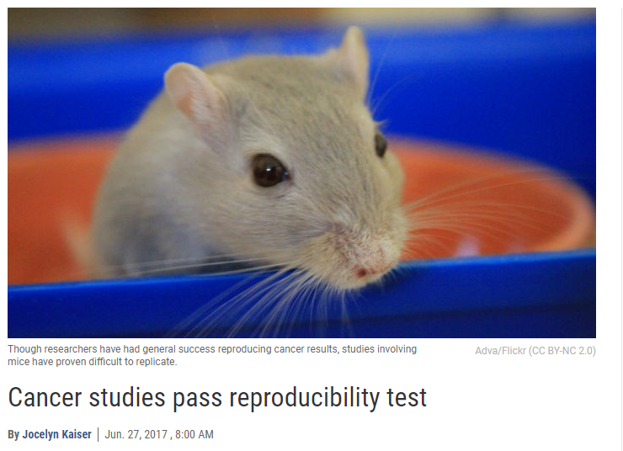
Not all gloom and doom
Aforementioned reproducibility project round 2
Recall:
First Batch (Jan 2020): of five replications, only two studies could be reproduced
Second Batch (Jun 2020): Most of the experiments from two key cancer papers could be repeated.
The cancer biology project hopes to finish experiments for another 22 replications by the end of this year (2020), when the grant funding the effort runs out
Kaiser J., 2020. “Cancer studies pass reproducibility test,” 26–26-Jun-2020. [Online]. Available: http://www.sciencemag.org/news/2020/06/cancer-studies-pass-reproducibility-test.

Slide 39
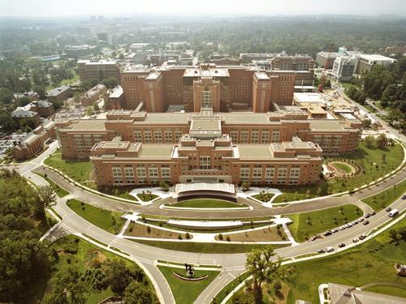
Hollie’s Corner
We sell you the whole seat, but you’ll only need the edge!

Slide 40
Rigor & Reproducibility:
A Case Study

Slide 41

Amy Cuddy - Power Posing, “free, no-tech life hack”
https://www.youtube.com/watch?v=C4ACeoqEjeA

Slide 42
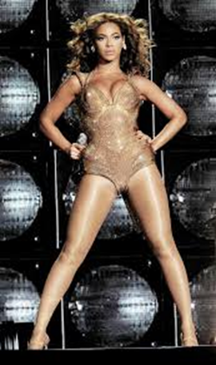
The Power Pose Study’s Rise to “Power”
October 2010 – Power Posing Paper Published
Dana Carney, Amy Cuddy, and Andy Yap in Psychological Science
High-power posers experienced elevations in testosterone, decreases in cortisol, and increased feelings of power and tolerance for risk; low-power posers exhibited the opposite pattern
Fall 2010 – Fake It Until You Make It
Harvard Business School promotes study
April 2011- Matter Over Mind
David Brooks op-ed column in promotes power posing in The New York Times
June 2012 – Your Body Language Shapes Who You Are
Amy Cuddy gives a TED talk (most watched of all time!)
February 2016 – The Late Show with Stephen Colbert
Cuddy appears on talk shows gaining pop culture attention

Slide 43
The Power Pose Study’s Demise
March 2015 - Ranehill Replication Study (has badges!)
Replicated self-reported feelings of power
Could not replicate increased levels testosterone and cortisol or financial risk taking
Oct 2016 - Dana Carney Mea Culpa
Called sample size "tiny" and noted that the effects are "small and barely there in some cases"
Admitted that the self-reported feelings of power were p-hacked
Admitted saliva samples used to test hormone levels were taken after subjects discovered whether they had won an extra $2 as part of the risk-taking portion of the study (research indicates winning alone can boost testosterone)
June 2016 - Garrison Replication Study of Self-Reported-Feelings of Power Posing
Reported a more expansive pose reduced feelings of power compared to adopting a more contractive pose
Fall 2016 - TED’s Response
"Some of the findings presented in this talk have been referenced in an ongoing debate among social scientists about robustness and reproducibility." TED also included a link to Cuddy’s defense of the study.

Slide 44
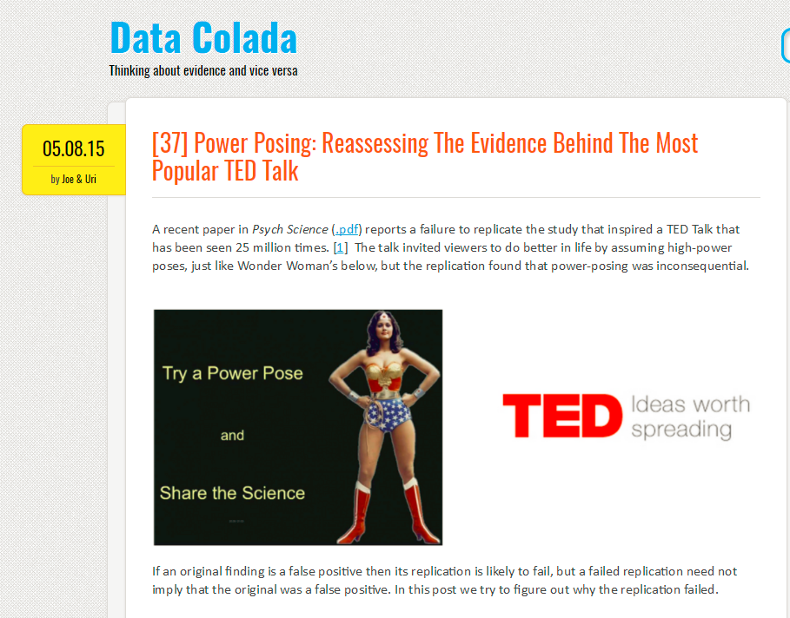
http://datacolada.org/37

Slide 45
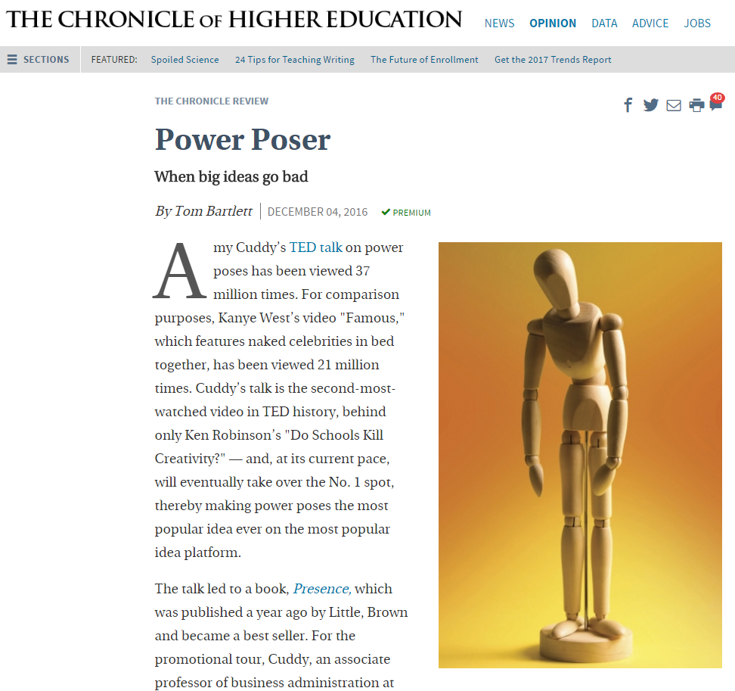
http://www.chronicle.com/article/When-Big-Ideas-Go-Bad/238544?cid=cr&utm_source=cr&utm_medium=en&elqTrackId=88a4ea63398a4d02aee5ea9b1e59bd4a&elq=c3c147812ee14f73905c2d0295d7d74c&elqaid=11695&elqat=1&elqCampaignId=4658

Slide 46
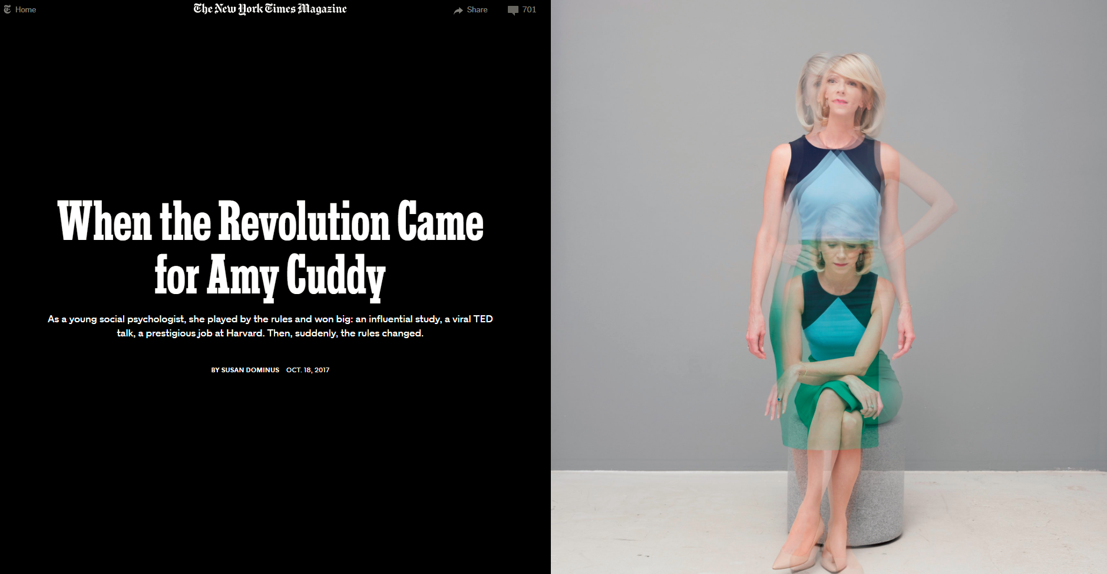
https://www.nytimes.com/2020/10/18/magazine/when-the-revolution-came-for-amy-cuddy.html?_r=0

Slide 47
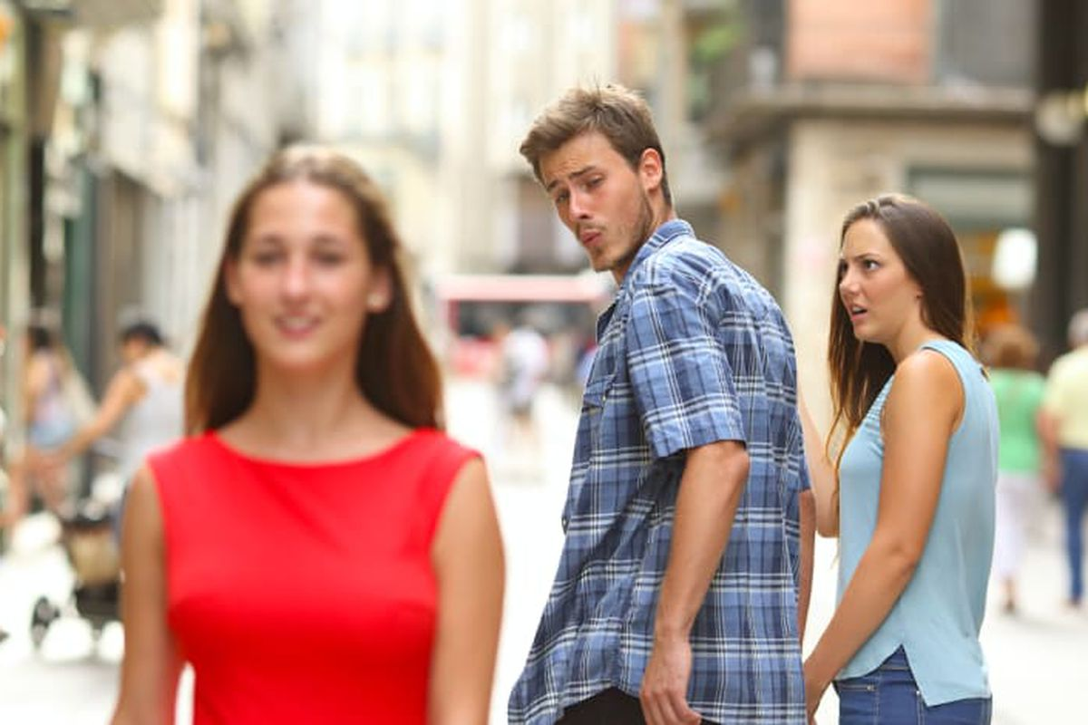
Time/Mood check
Andy’s
ADHD
NIH facts and guiding principles
Workshop

Slide 48
Rigor & Reproducibility @ NIH

Slide 49
NIH – Part of the Problem?
Significance
Investigator(s)
Innovation
Approach
Environment

Slide 50
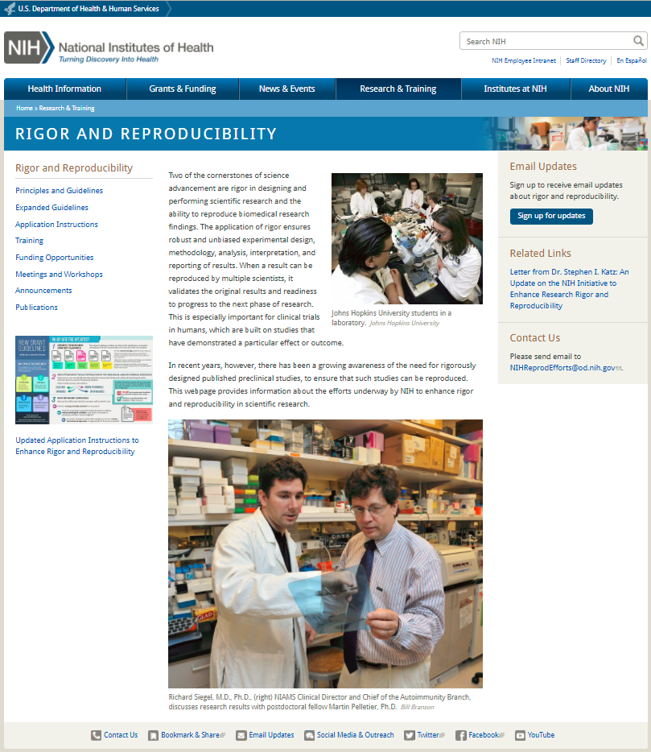
https://www.nih.gov/research-training/rigor-reproducibility

Slide 51
NIH Guiding Principles for Rigor & Transparency
Clarify NIH’s long-standing expectations regarding rigor and transparency and how we would like to see this described in applications
Raise awareness and begin culture shifts in the scientific community
Prompt applicants to consider issues that they may have previously down-played or ignored, which may have a detrimental effect on the quality of the science they produce
NIH Rigor & Reproducibility Lecture, NIH Regional Seminar, Oct 17, 2015

Slide 52
NIH Guiding Principles for Rigor & Transparency, cont.
Improve the way that applicants describe their work; provide sufficient information for reviewers
Demonstrate to our public stakeholders that NIH is seriously considering their concerns
As always, ensure that NIH is investing in the best science and minimizing unnecessary burden
NIH Rigor & Reproducibility Lecture, NIH Regional Seminar, Oct 17, 2015

Slide 53
Principles and Guidelines for Reporting Preclinical Research
Rigorous statistical analyses
Transparency in reporting
Data and material sharing
Consideration of refutations
Consider establishing best practice guidelines
Endorsements – Principles and Guidelines for Reporting Preclinical Research

Slide 54
Transparency in Reporting
Standards: Encourage the use of community-based standards (such as nomenclature standards and reporting standards like ARRIVE), where applicable.
Replicates: Require that investigators report how often each experiment was performed and whether the results were substantiated by repetition under a range of conditions. Sufficient information about sample collection must be provided to distinguish between independent biological data points and technical replicates.
Statistics: Require that statistics be fully reported in the paper, including the statistical test used, exact value of N, definition of center, dispersion and precision measures (e.g., mean, median, SD, SEM, confidence intervals)
Randomization: Require authors to state whether the samples were randomized and specify method of randomization, at a minimum for all animal experiments.
Blinding: Require authors to state whether experimenters were blind to group assignment and outcome assessment, at a minimum for all animal experiments.
Sample-size estimation: Require authors to state whether an appropriate sample size was computed when the study was being designed and include the statistical method of computation. If no power analysis was used, include how the sample size was determined.
Inclusion and exclusion criteria: Require authors to clearly state the criteria that were used for exclusion of any data or subjects. Include any similar experimental results that were omitted from the reporting for any reason, especially if the results do not support the main findings of the study. Describe any outcomes or conditions that were measured or used and are not reported in the results section.

Slide 55
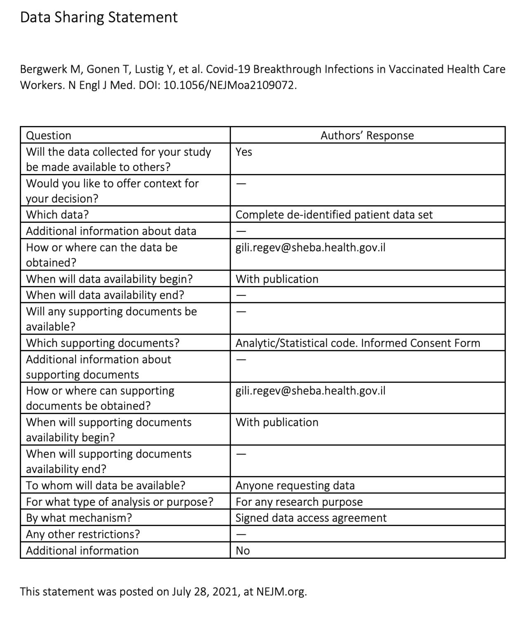
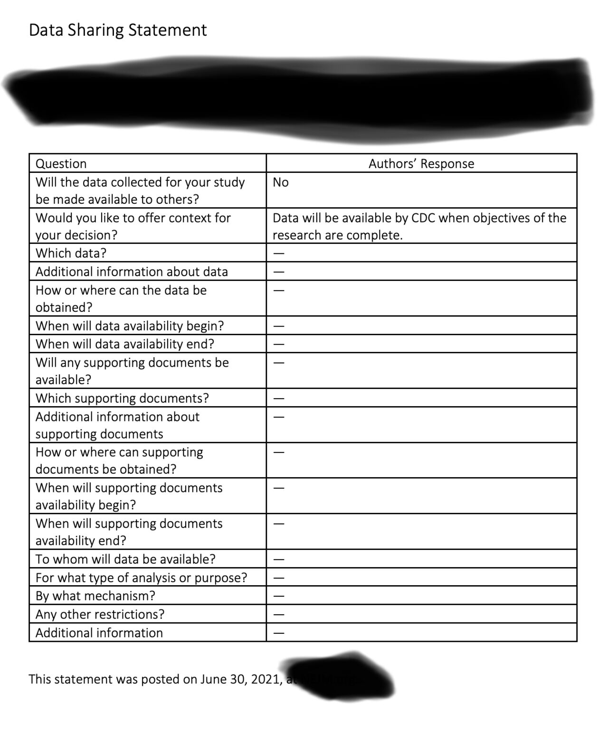
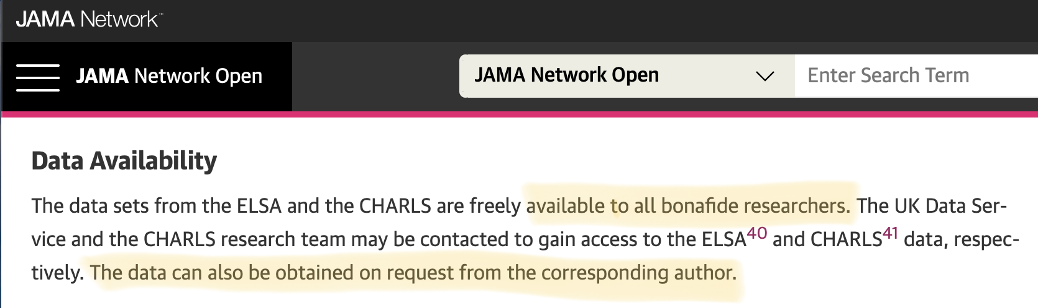
Data and Material Sharing
Stipulate, at the minimum, that all datasets on which the conclusions of the paper rely must be made available upon request (where ethically appropriate) during consideration of the manuscript (by editors and reviewers) and upon reasonable request immediately upon publication.
Recommend deposition of datasets in public repositories, where available. Datasets in repositories should be bidirectionally linked to the published article in a way that ensures proper attribution of data production.
Encourage presentation of all other data values in machine readable format in the paper or its supplementary information. Require materials sharing after publication.
Encourage sharing of software and require at the minimum a statement in the manuscript describing if software is available and how it can be obtained.

Slide 56
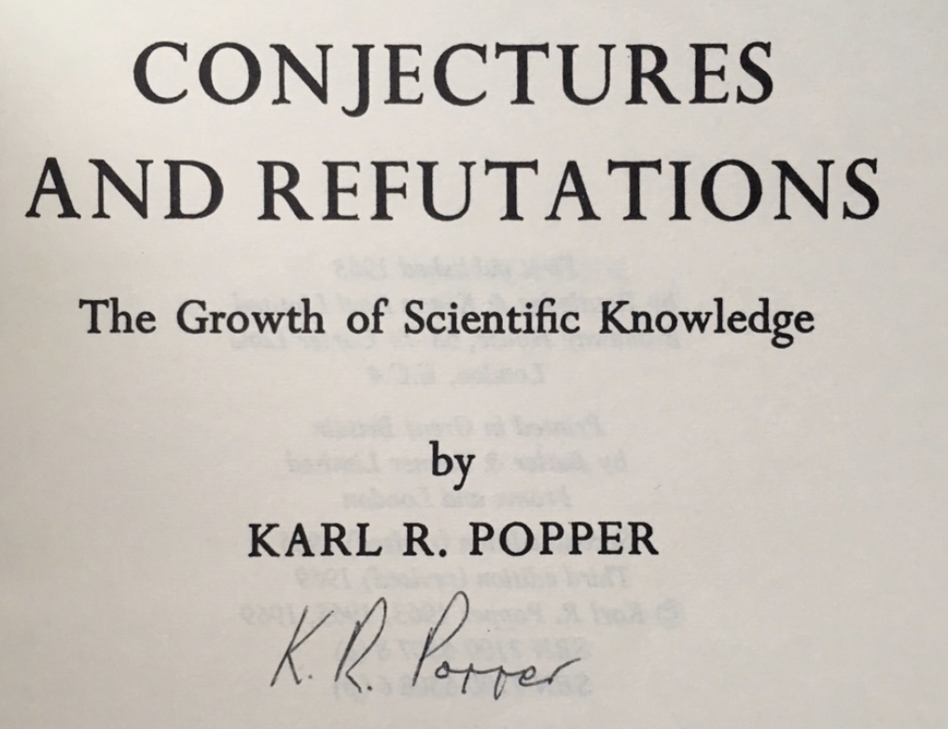
Consideration of Refutations
Have a policy stating that if the journal publishes a paper, it assumes responsibility to consider publication of refutations of that paper, according to its usual standards of quality.

Slide 57
Rigor & Reproducibility Requirements
for NIH Applications
SKIP TO
R&R @U

Slide 58
Endorsements
Endorsements – Principles and Guidelines for Reporting Preclinical Research
https://www.nih.gov/sites/default/files/research-training/initiatives/reproducibility/rigor-reproducibility-endorsements.pdf

Slide 59
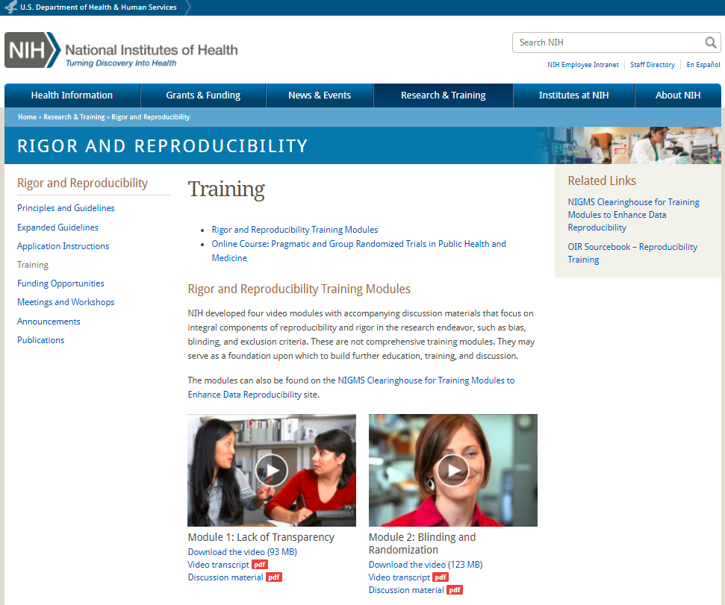
https://www.nih.gov/research-training/rigor-reproducibility/training

Slide 60
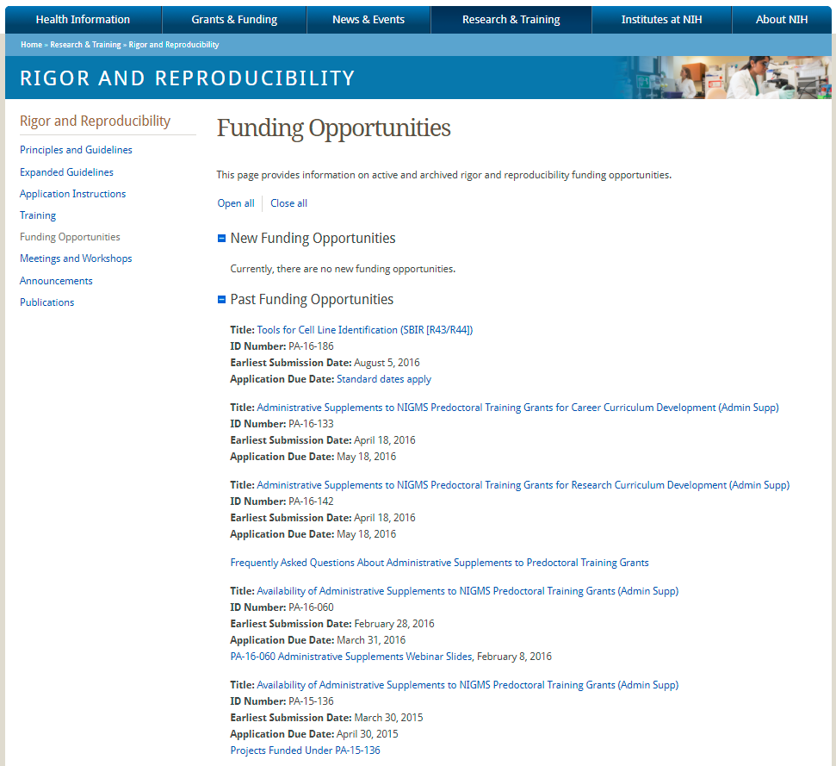
https://www.nih.gov/research-training/rigor-reproducibility/funding-opportunities

Slide 61
Rigor and Transparency
Three elements of the policy should be addressed within the Research Strategy section of your application and your Progress Report
Scientific premise
Scientific rigor
Relevant biological variables such as sex
Authentication of of Key Biological and/or Chemical Resources
http://grants.nih.gov/grants/guide/notice-files/NOT-OD-16-011.html
http://grants.nih.gov/grants/guide/notice-files/NOT-OD-16-012.html

Slide 62
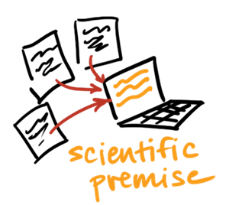
Rigor and Transparency
Scientific Premise
Describe the general strengths and weaknesses of the prior research being cited by the applicant as crucial to support the application.
Include consideration of the rigor of the previous studies, as well as the incorporation of relevant biological variables and authentication of key resources.
Review Question: Is there strong scientific premise for the project?”
NIH Rigor & Reproducibility Lecture, NIH Regional Seminar, Oct 17, 2015

Slide 63
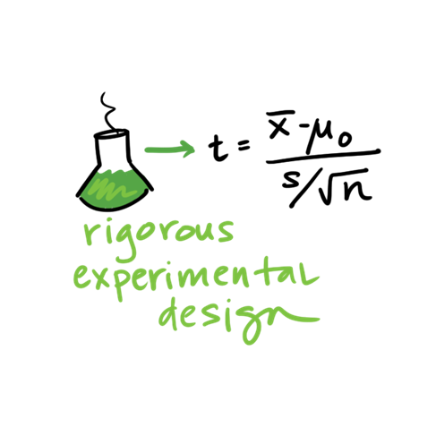
Rigor and Transparency
Scientific Rigor
Strict application of the scientific method to ensure robust and unbiased experimental design, methodology, analysis, interpretation and reporting of results.
Describe the study design and methods proposed and how they will achieve robust and unbiased results.
Review Question: Have the investigators presented strategies to ensure a robust and unbiased approach, as appropriate for the work proposed?
NIH Rigor & Reproducibility Lecture, NIH Regional Seminar, Oct 17, 2015

Slide 64
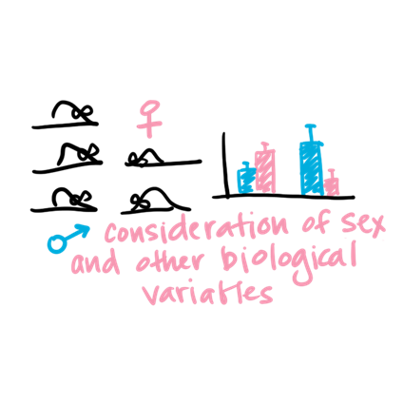
Rigor and Transparency
Relevant Biological Variables, such as sex
Explain how relevant biological variables, such as sex, are factored into research designs and analyses for studies in vertebrate animals and humans
strong justification from the scientific literature, preliminary data, or other relevant considerations, must be provided for applications proposing to study only one sex
NIH Rigor & Reproducibility Lecture, NIH Regional Seminar, Oct 17, 2015

Slide 65
Rigor and Transparency
Element of Rigor | Section of Application | Criterion Score | Additional Review Consideration | Contribute to Overall Impact?
Scientific Premise | Research Strategy | Significance | NA | Yes
Scientific Rigor |  | Approach | NA | Yes
Consideration of Sex and Other Relevant Biological Variables |  | Approach | NA | Yes
Authentication of Key Biological and/or Chemical Resources | New Attachment | NA | Acceptable or unacceptable | No

Slide 66
Resources
NIH FAQ page
http://grants.nih.gov/grants/forms_updates_faq.htm
‘Rigor & Reproducibility: Back to Basics’
NIH Regional Seminar, Oct 17, 2015
http://regionalseminars.od.nih.gov/sandiego2015/presentations/
NIH Reviewer Guidance on Rigor and Transparency
https://grants.nih.gov/grants/peer/guidelines_general/Reviewer_Guidance_on_Rigor_and_Transparency.pdf

Slide 67
Rigor & Reproducibility:
@ The U

Slide 68
What are we doing?
Resources @ Eccles Health Sciences Library
Research Reproducibility Coalition
Grand Rounds: Research Reproducibility (#UtahGRRR)
Research Reproducibility 2018 (#UtahRR18)
Research Reproducibility 1 credit course

Slide 69
Resources

Slide 70
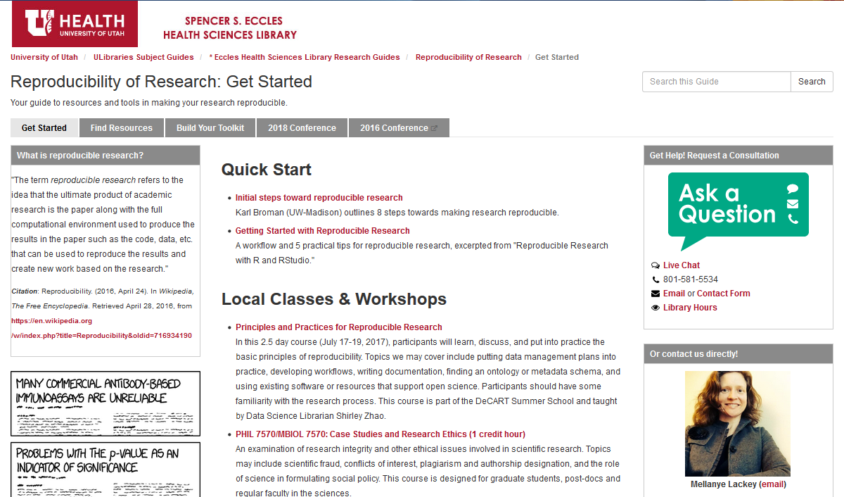
http://campusguides.lib.utah.edu/reproducibility/start

Slide 71
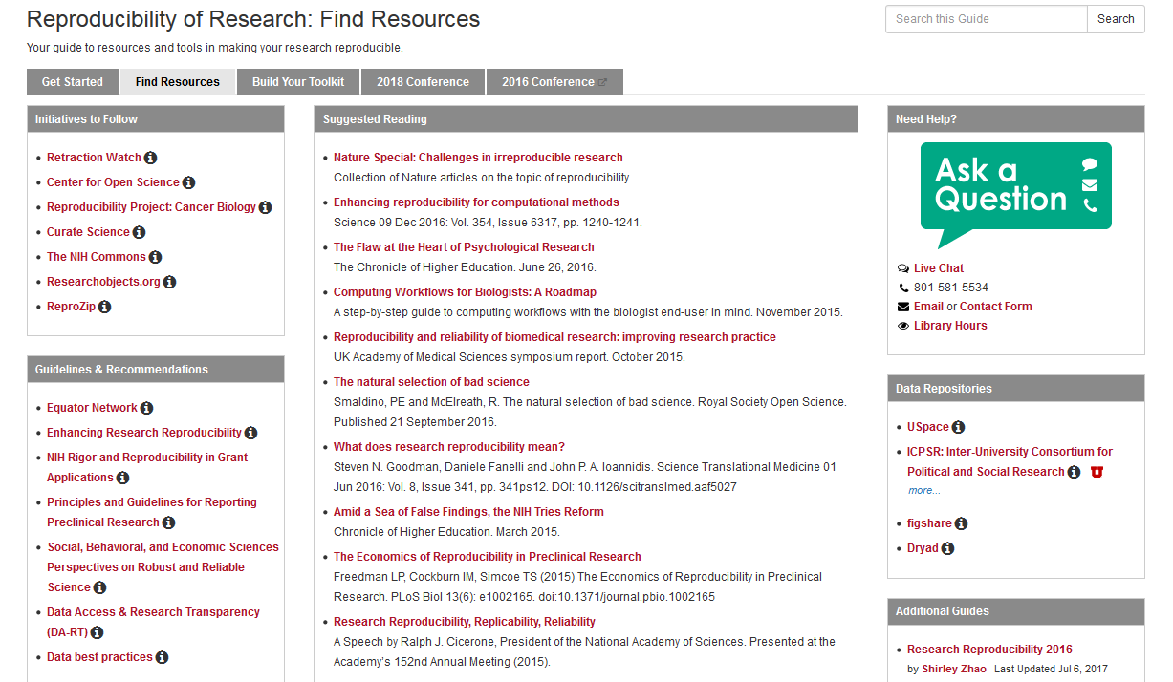

Slide 72
Research Reproducibility Coalition

Slide 73
What is the Coalition?
Interested people and leaders in reproducibility
Meets quarterly
Forum, discussion group
What can we do to advance reproducibility?
To join email melissa.rethlefsen@utah.edu

Slide 74
Grand Rounds:
Research Reproducibility

Slide 75


Slide 76
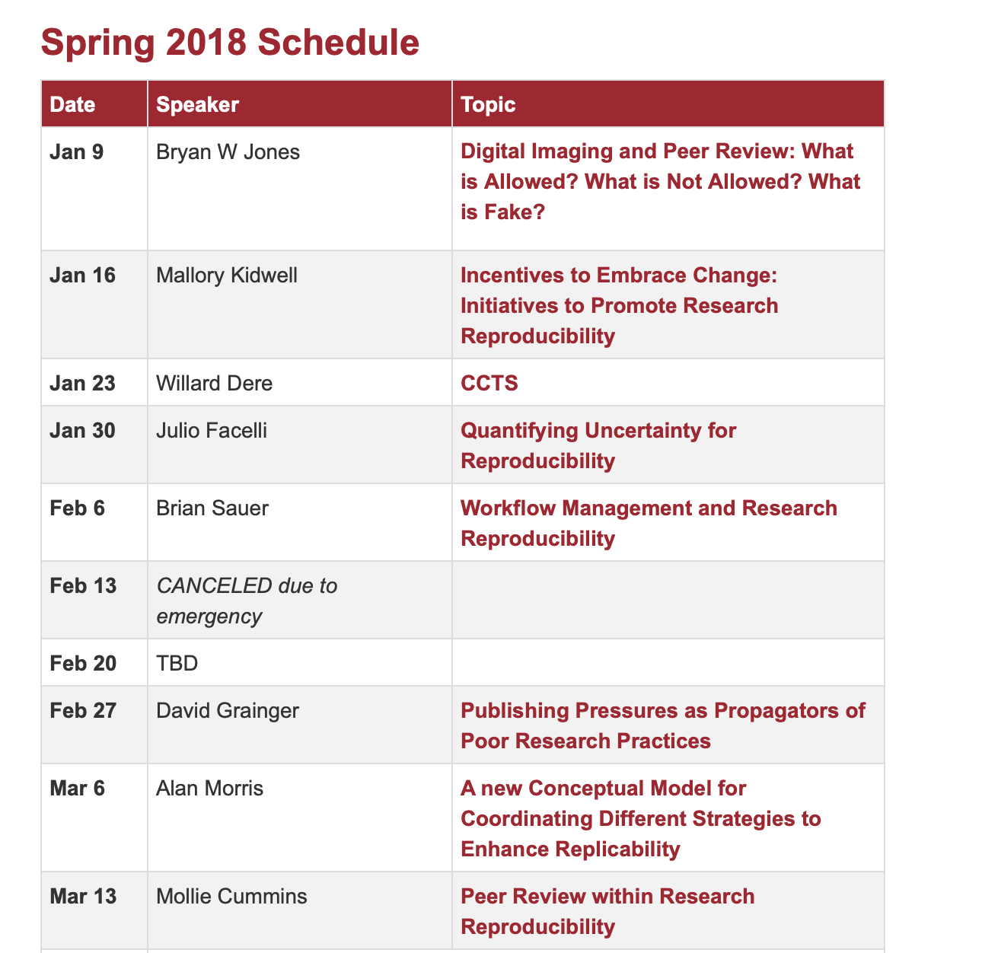

Where can I go?
Tuesdays, 12-1 pm, EHSL Synapse
Twitter: #UtahGRRR
Schedule: http://campusguides.lib.utah.edu/UtahRR18/GRRR
Videos: https://library.med.utah.edu/e-channel/portfolio/research-reproducibility-conference/

Slide 77
Research Reproducibility 2018 (#UtahRR18)

Slide 78
UtahRR18 – June 15, 2017
Conference Theme: Building Research Integrity Through Reproducibility
Web Site: http://campusguides.lib.utah.edu/UtahRR18/Conference
I think there was another one in 2018

Slide 79
Questions?

Slide 80
To the Workshop!
https://osf.io/wpqsv/

